Slide 1
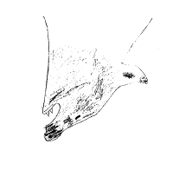
A Day In The Life Of A Wolf
Charlotte Pole

Slide 2
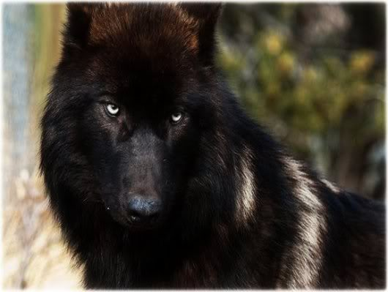
The smooth, black female alpha and her pack are getting ready to hunt. There are some caribou in the south side of the forest but they are moving quickly so they must be quick. Two sick wolves and one healthy female will stay behind in the den to take care of the pups and cubs. The wolves set off.

Slide 3
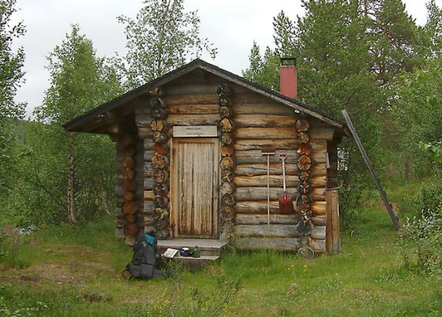
Meanwhile in the nearby village two hunters are getting ready to go into the forest to hunt for wolves. They put on there heavy boots and go out of the door. They stomp on the gravel path which blends into the soily forest floor coved in dead leaves. They make there way into the gloomy forest.

Slide 4
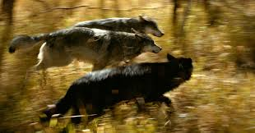
Galloping through the dark forest with the alpha close behind the pack comes to a halt. The alpha leaps to the front. A twig snaps, then another.

Slide 5
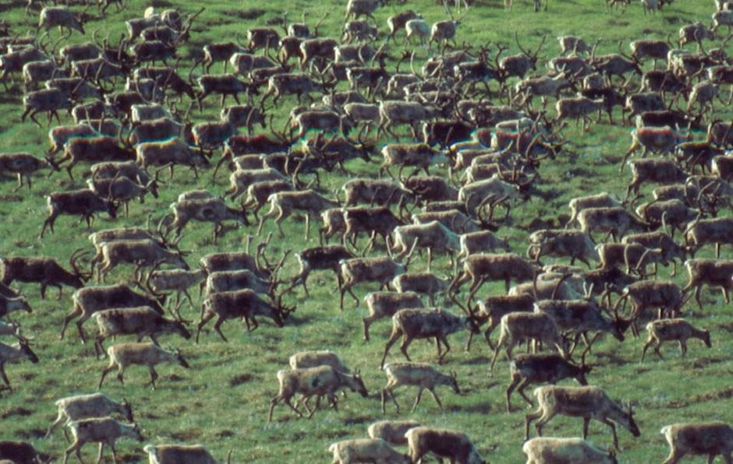
BANG! Its not caribou it’s the hunters. The wolves turn and run. The hunters run after them. They speed past the den and the pups and cubs join the rest of the pack the ill and the healthy female try to pull them back but it fails the 3 wolves and 1 pup gets shot.

Slide 6
The hunters still chase to pack though they don’t just want 1 wolf they want the whole pack. The village is starving because the wolves take all the meet.

Slide 7
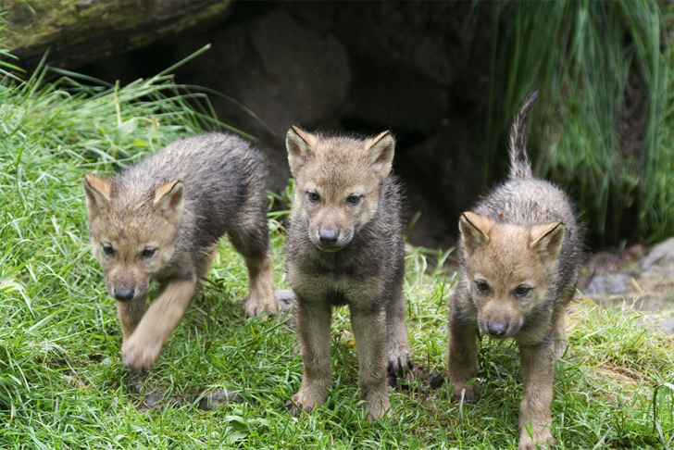
The 3 cubs left were behind the rest of the pack but there catching up. The pack soon comes to a pack of buffalo for once they are not running from each other but they are running together. BANG! BANG! BANG! The cubs are dead the hunters stop running they take the dead wolves back to the village. The wolves rest.
Notes:
hello

Slide 8
The End

