Slide 1
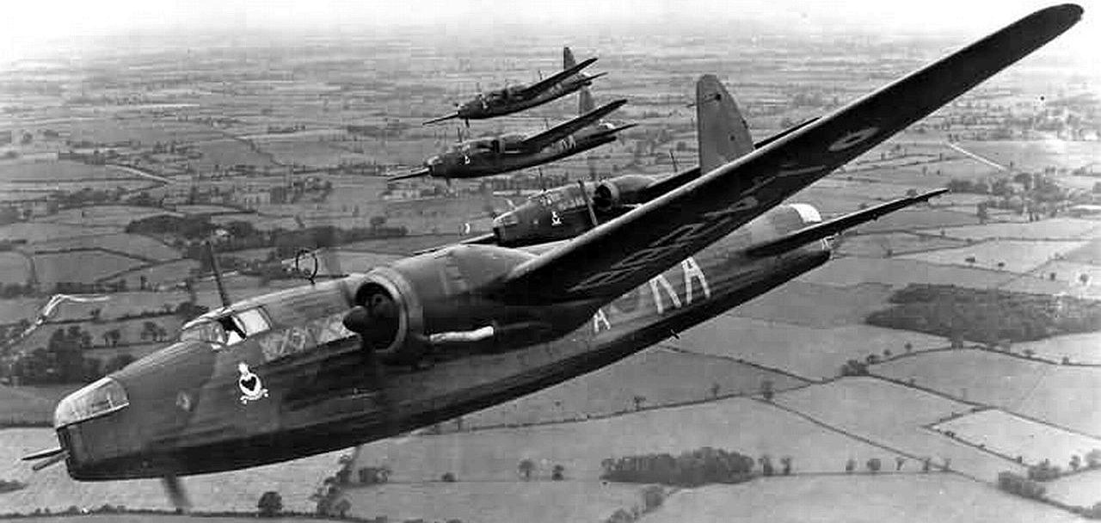
WW2 BLITZ

Slide 2
What was the Blitz ?
The blitz was a German bombing campaign that ranged between 1940 and 1941. The Germans conducted mass air attacks against industrial cities and towns around London. The raids began with light bombing and towards the end they would start to get heavier. In the end period of the Blitz the Battle of Britain began. It was an enormous battle of dog fights and bombing which the Luftwaffe and Royal air force battled for air superiority amongst the air. In the end the Luftwaffe had failed and the German air fleets retreated and were ordered to attack London to draw the RAF towards what was called the battle of annihilation.

Slide 3
Children in the blitz
Children and babies in WWII had Gas masks and bomb shelters to keep them safe. If they were in school sand a bomb set of they were forced to walk single file to either the nearest public bomb raid shelters or if the school had one they would bring their school books and pencils and do their work in them. The shelters made at the schools were concrete bunkers with wooden benches either side which were used to let the children sit and do their work. If they were caught at home during the Blitz they would have to refuge underneath tables book cases and even ironing boards

Slide 4
The effect of the blitz
Blitz devastation
The effect the Blitz had on London killed over millions of people and wounded more than thousands. It demolished houses schools and factories which would have been packed with thousands of Women.
Notes:
This is to s

